Slide 1
Strings
4.5

Slide 2
String Type
A string is a sequence of characters.
String name = "Harry";
A string variable is a variable that can hold a string
String literals are character sequences enclosed in quotes A string literal denotes a particular string
"Harry"
String length is the number of characters in the string
The length of "Harry" is 5
The length method yields the number of characters in a string
int n = name.length();
A string of length 0 is called the empty string
Contains no characters Is written as ""

Slide 3
Concatenation
Concatenating strings means to put them together to form a longer string Use the + operator:
Example:
String fName = "Harry"; String lName = "Morgan"; String name = fName + lName;
Result:
"HarryMorgan"
To separate the first and last name with a space
String name = fName + " " + lName;
Results in
"Harry Morgan"

Slide 4
Concatenation
If one of the arguments of the + operator is a string
The other is forced to become to a string: Both strings are then concatenated
Example
String jobTitle = "Agent"; int employeeId = 7;
String bond = jobTitle + employeeId;
Result
"Agent7"

Slide 5
String Input
Use the next method of the Scanner class to read a string containing a single word.
System.out.print("Please enter your name: "); String name = in.next();
Only one word is read.
Use a second call to in.next to get a second word.

Slide 6
Escape Sequences
To include a quotation mark in a literal string, precede it with a backslash ( \ )
"He said \"Hello\""
Indicates that the quotation mark that follows should be a part of the string and not mark the end of the string
Called an escape sequence
To include a backslash in a string, use the escape sequence \\
"C:\\Temp\\Secret.txt"
A newline character is denoted with the escape sequence \n
A newline character is often added to the end of the format string when using
System.out.printf:
The negative left justifies
System.out.printf("%-10s %6.2f\n", “Price:”,price);

Slide 7

Strings and Characters
A string is a sequences of Unicode characters. A character is a value of the type char.
Characters have numeric values
Character literals are delimited by single quotes.
'H' is a character. It is a value of type char
Don't confuse them with strings
"H" is a string containing a single character. It is a value of type String.

Slide 8

Strings and Characters
String positions are counted starting with 0.
The position number of the last character is always one less than the length of the string.
The last character of the string "Harry" is at position 4 The charAt method returns a char value from a string The example
String name = "Harry";
char start = name.charAt(0); char last = name.charAt(4);
Sets start to the value 'H' and last to the value 'y'.

Slide 9


Substrings
Use the substring method to extract a part of a string. The method call str.substring(start, pastEnd)
returns a string that is made up of the characters in the string str,
starting at position start, and
containing all characters up to, but not including, the position pastEnd.
Example:
String greeting = "Hello, World!";
String sub = greeting.substring(0, 5); // sub is "Hello"
To extract "World"
String sub2 = greeting.substring(7, 12);
Substring length is “past the end” - start

Slide 10
Substrings
If you omit the end position when calling the substring method, then all characters from the starting position to the end of the string are copied.
Example
String tail = greeting.substring(7);
// Copies all characters from position 7 on
Result
Sets tail to the string "World!".

Slide 11
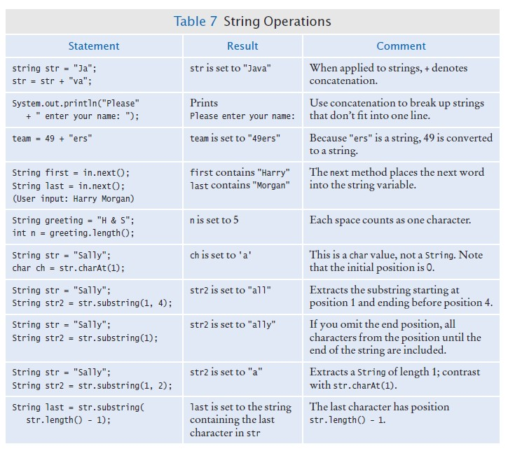

Slide 12
Conversion to numerical Data
To convert a String to a number:
Double.parseDouble(String)
Integer.parseInt(String)

Slide 13
Try it
Write a short program (Main method only) which will prompt the user to enter their name and a 10 digit telephone number is the format xxxxxxxxxx and will use substrings to return the same phone number in the format (xxx) xxx-xxxx. Print the name using printf so the name takes up 20 characters left justified followed by the phone number.
Print out your code and console output to turn in tomorrow

